Slide 1
Matrix Algebra
THE INVERSE OF A MATRIX

Slide 2



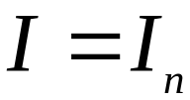



MATRIX OPERATIONS
An matrix A is said to be invertible if there is an matrix C such that
and
where , the identity matrix.
In this case, C is an inverse of A.
In fact, C is uniquely determined by A, because if B were another inverse of A, then
.
This unique inverse is denoted by , so that
and .

Slide 3
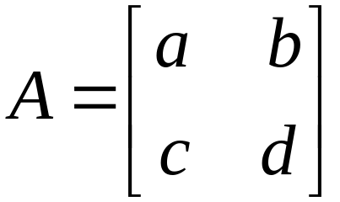

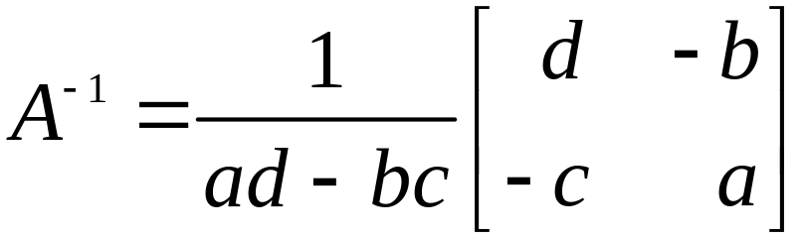





MATRIX OPERATIONS
Theorem 4: Let . If , then
A is invertible and
If , then A is not invertible.
The quantity is called the determinant of A, and we write
This theorem says that a matrix A is invertible if and only if det .

Slide 4








MATRIX OPERATIONS
Theorem 5: If A is an invertible matrix, then for each b in , the equation has the unique solution .
Proof: Take any b in .
A solution exists because if is substituted for x, then .
So is a solution.
To prove that the solution is unique, show that if u is any solution, then u must be .
If , we can multiply both sides by and obtain , , and .

Slide 5
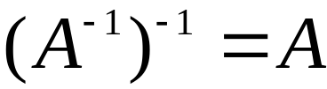
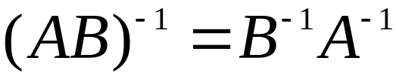
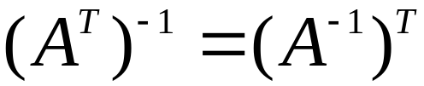
MATRIX OPERATIONS
Theorem 6:
    If A is an invertible matrix, then is invertible and
    If A and B are invertible matrices, then so is AB, and the inverse of AB is the product of the inverses of A and B in the reverse order. That is,
    If A is an invertible matrix, then so is A^{T}, and the inverse of A^{T} is the transpose of . That is,

Slide 6


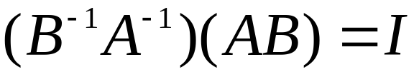
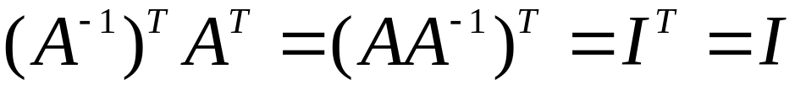
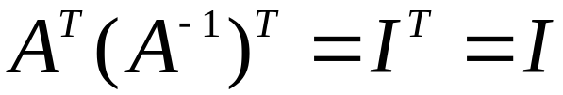
MATRIX OPERATIONS
Proof: To verify statement (a), find a matrix C such that
and
These equations are satisfied with A in place of C. Hence is invertible, and A is its inverse.
Next, to prove statement (b), compute:
A similar calculation shows that .
For statement (c), use Theorem 3(d), read from right to left, .
Similarly, .

Slide 7
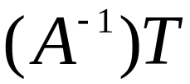
ELEMENTARY MATRICES
Hence A^{T} is invertible, and its inverse is .
The generalization of Theorem 6(b) is as follows:
The product of invertible matrices is invertible, and the inverse is the product of their inverses in the reverse order.
An invertible matrix A is row equivalent to an identity matrix, and we can find by watching the row reduction of A to I.
An elementary matrix is one that is obtained by performing a single elementary row operation on an identity matrix.

Slide 8
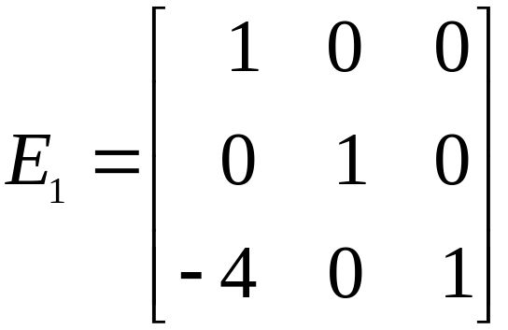
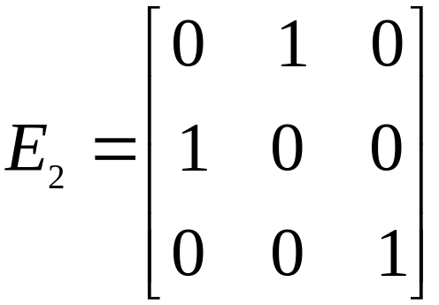
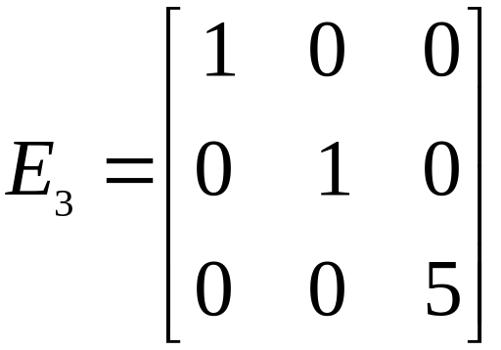
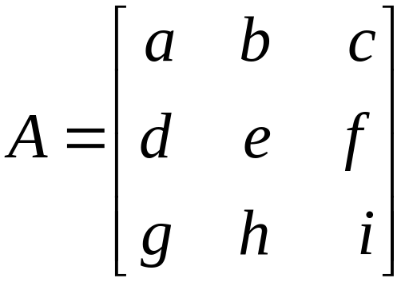
ELEMENTARY MATRICES
Example 1: Let , ,
,
Compute E₁A, E₂A, and E₃A, and describe how these products can be obtained by elementary row operations on A.

Slide 9
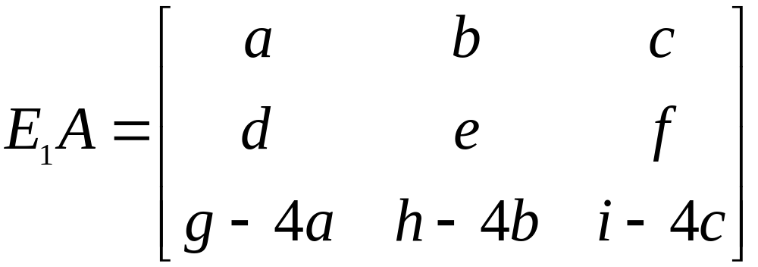
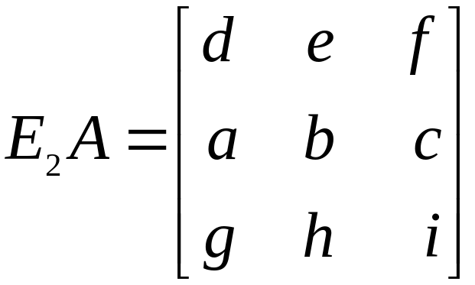
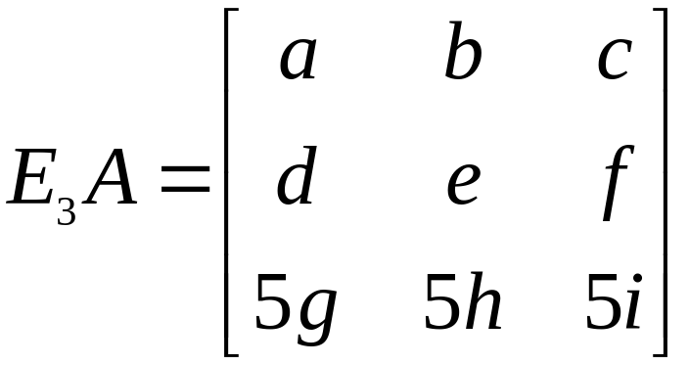

ELEMENTARY MATRICES
Solution: Verify that
, ,
.
Addition of times row 1 of A to row 3 produces E₁A.

Slide 10

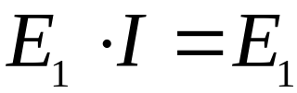
ELEMENTARY MATRICES
An interchange of rows 1 and 2 of A produces E₂A, and multiplication of row 3 of A by 5 produces E₃A.
Left-multiplication by E₁ in Example 1 has the same effect on any matrix.
Since , we see that E₁ itself is produced by this same row operation on the identity.

Slide 11


ELEMENTARY MATRICES
Example 1 illustrates the following general fact about elementary matrices.
If an elementary row operation is performed on an
matrix A, the resulting matrix can be written as EA, where the matrix E is created by performing the same row operation on I_{m}.
Each elementary matrix E is invertible. The inverse of E is the elementary matrix of the same type that transforms E back into I.

Slide 12
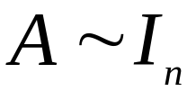
ELEMENTARY MATRICES
Theorem 7: An matrix A is invertible if and only if A is row equivalent to I_{n}, and in this case, any sequence of elementary row operations that reduces A to I_{n} also transforms I_{n} into .
Proof: Suppose that A is invertible.
Then, since the equation has a solution for each b (Theorem 5), A has a pivot position in every row.
Because A is square, the n pivot positions must be on the diagonal, which implies that the reduced echelon form of A is I_{n}. That is, .

Slide 13
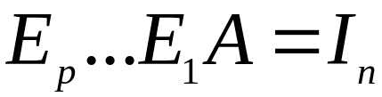
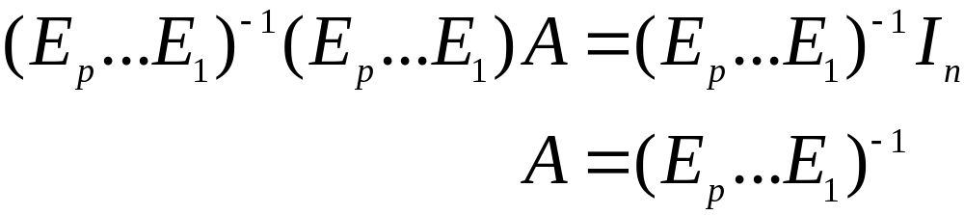
ELEMENTARY MATRICES
Now suppose, conversely, that .
Then, since each step of the row reduction of A corresponds to left-multiplication by an elementary matrix, there exist elementary matrices E₁, …, E_{p} such that
.
That is, ----(1)
Since the product E_{p}…E₁ of invertible matrices is invertible, (1) leads to
.

Slide 14

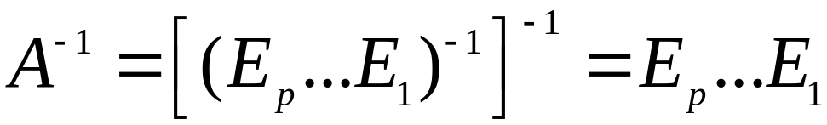
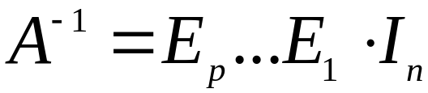
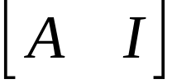

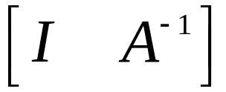
ALGORITHM FOR FINDING
Thus A is invertible, as it is the inverse of an invertible matrix (Theorem 6). Also,
.
Then , which says that results from applying E₁, ..., E_{p} successively to I_{n}.
This is the same sequence in (1) that reduced A to I_{n}.
Row reduce the augmented matrix . If A is row equivalent to I, then is row equivalent to
. Otherwise, A does not have an inverse.

Slide 15
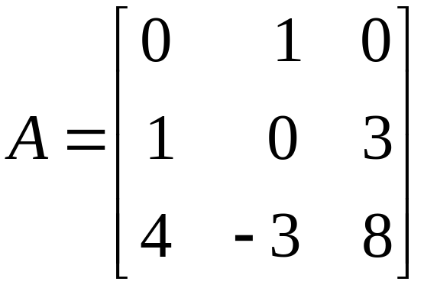
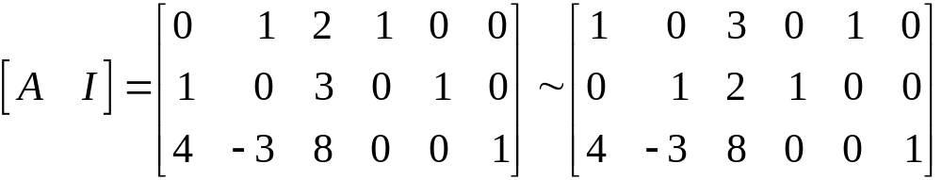
ALGORITHM FOR FINDING
Example 2: Find the inverse of the matrix
, if it exists.
Solution:

Slide 16
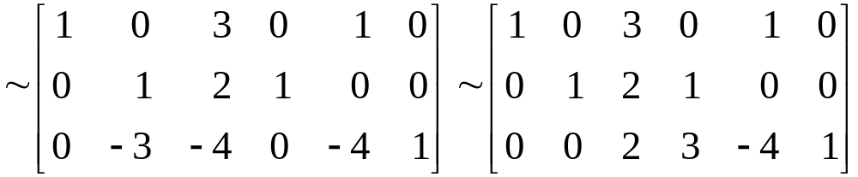
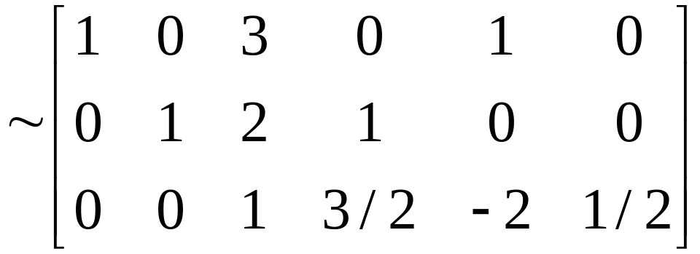
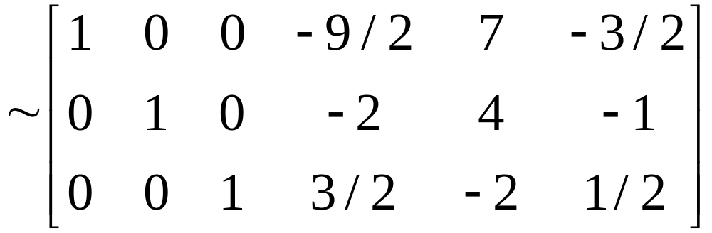
ALGORITHM FOR FINDING

Slide 17

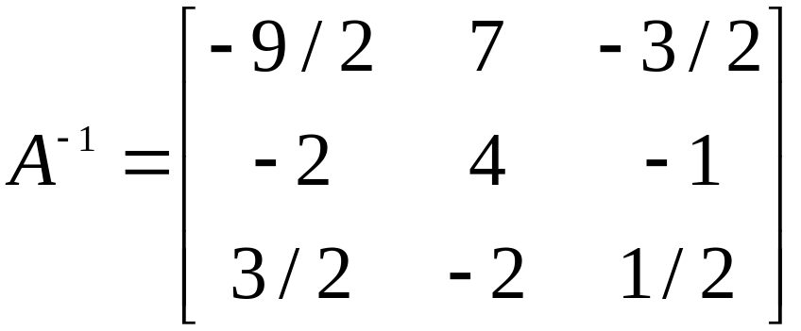
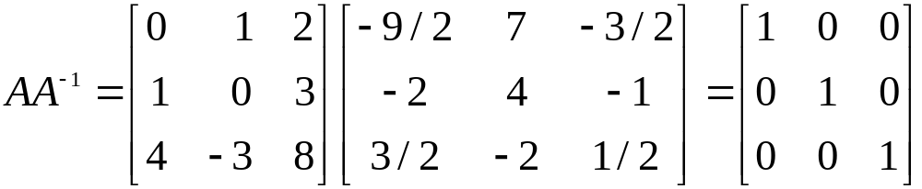
ALGORITHM FOR FINDING
Theorem 7 shows, since , that A is invertible, and
.
Now, check the final answer.

Slide 18
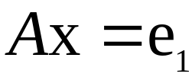
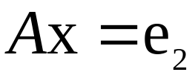
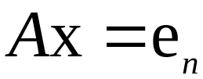
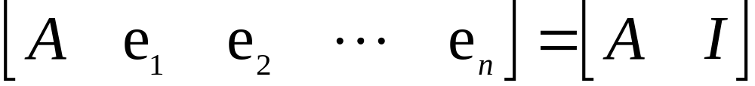
ANOTHER VIEW OF MATRIX INVERSION
It is not necessary to check that since A is invertible.
Denote the columns of I_{n} by e₁,…,e_{n}.
Then row reduction of to can be viewed as the simultaneous solution of the n systems
, , …, ----(2)
where the “augmented columns” of these systems have all been placed next to A to form
.

Slide 19
ANOTHER VIEW OF MATRIX INVERSION
The equation and the definition of matrix multiplication show that the columns of are precisely the solutions of the systems in (2).

